Slide 1

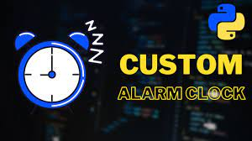
Personal Alarm Clock
By: Cedric Vilfort
A personalized alarm experience to help alert and wake you up at your desired time with custom features.
https://github.com/ksu-is/Personal-Alarm-clock

